Slide 1
此題不用上傳，寫於word report
write a function that switch two integers: swap()
1.Two integer parameters: after calling the function swap, the two parameters should be exchanged
2. No return value
Explain the following questions:
Can we use call by value to exchange the two values? Why?
Can we use call by address to exchange the two values? Why?
Please debug the program to show the differences of the two methods.

Slide 2
1.cpp (不可在function內列印，務必在main program 列印)
1. Convert binary to decimal
void bin_to_dec(int *num); //務必用call by address
Output:
Enter binary number: 1011
Binary number of decimal is 11

Slide 3
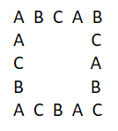
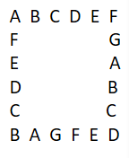
2.cpp
void draw(int m, int n);
請main program 內輸入m, n。Call draw(m, n);
利用m個字母，畫n*n的正方形。
(1). For m=3, n=5 (5*5 squaes: print A, B, C)
(2). For m=7, n=6 (6*6 squaes: print A, B, C, D, E, F, G)

